Slide 1
Memory
Randall C. O’Reilly

Slide 2
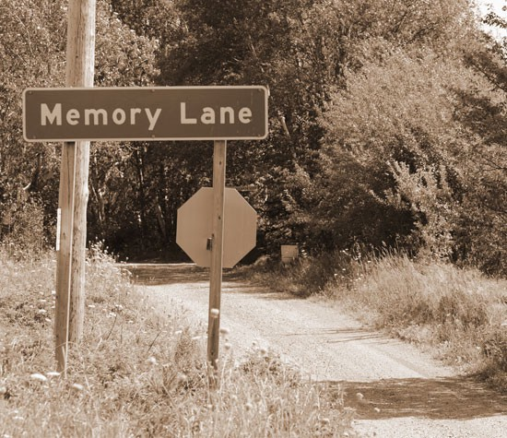


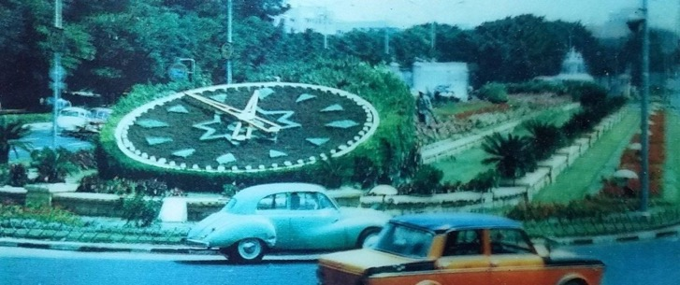
Memory: Its Personal

Slide 3
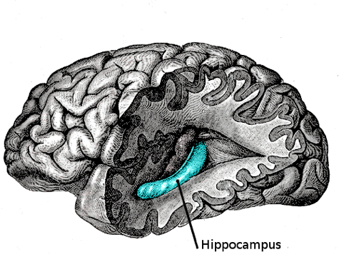
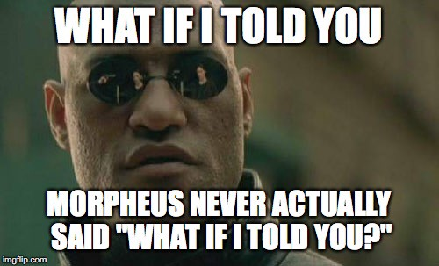
Your Own Personal Synapses…
YOUR MEMORIES ARE ALL JUST
SYNAPTIC WEIGHTS!?

Slide 4
Hippocampal Compression!

Slide 5
Memory Questions
What is memory?
How can I improve my memory?
Is Memory Accurate?

Slide 6
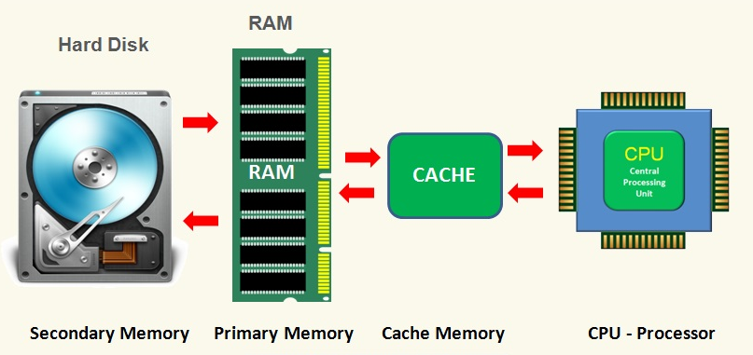
Computer Memory
RAM = Fast, Temporary
Hard Disk = Slower, Long Term
But… no RAM, Hard Disk equivalent in the Brain!

Slide 7
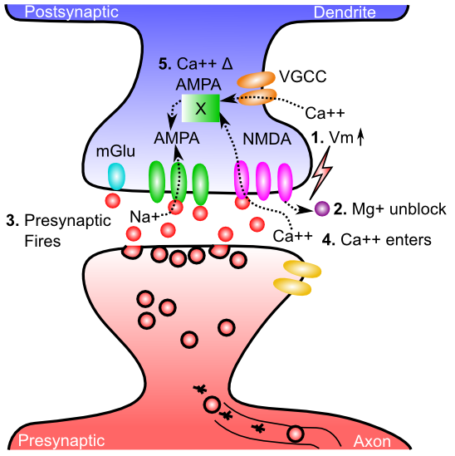
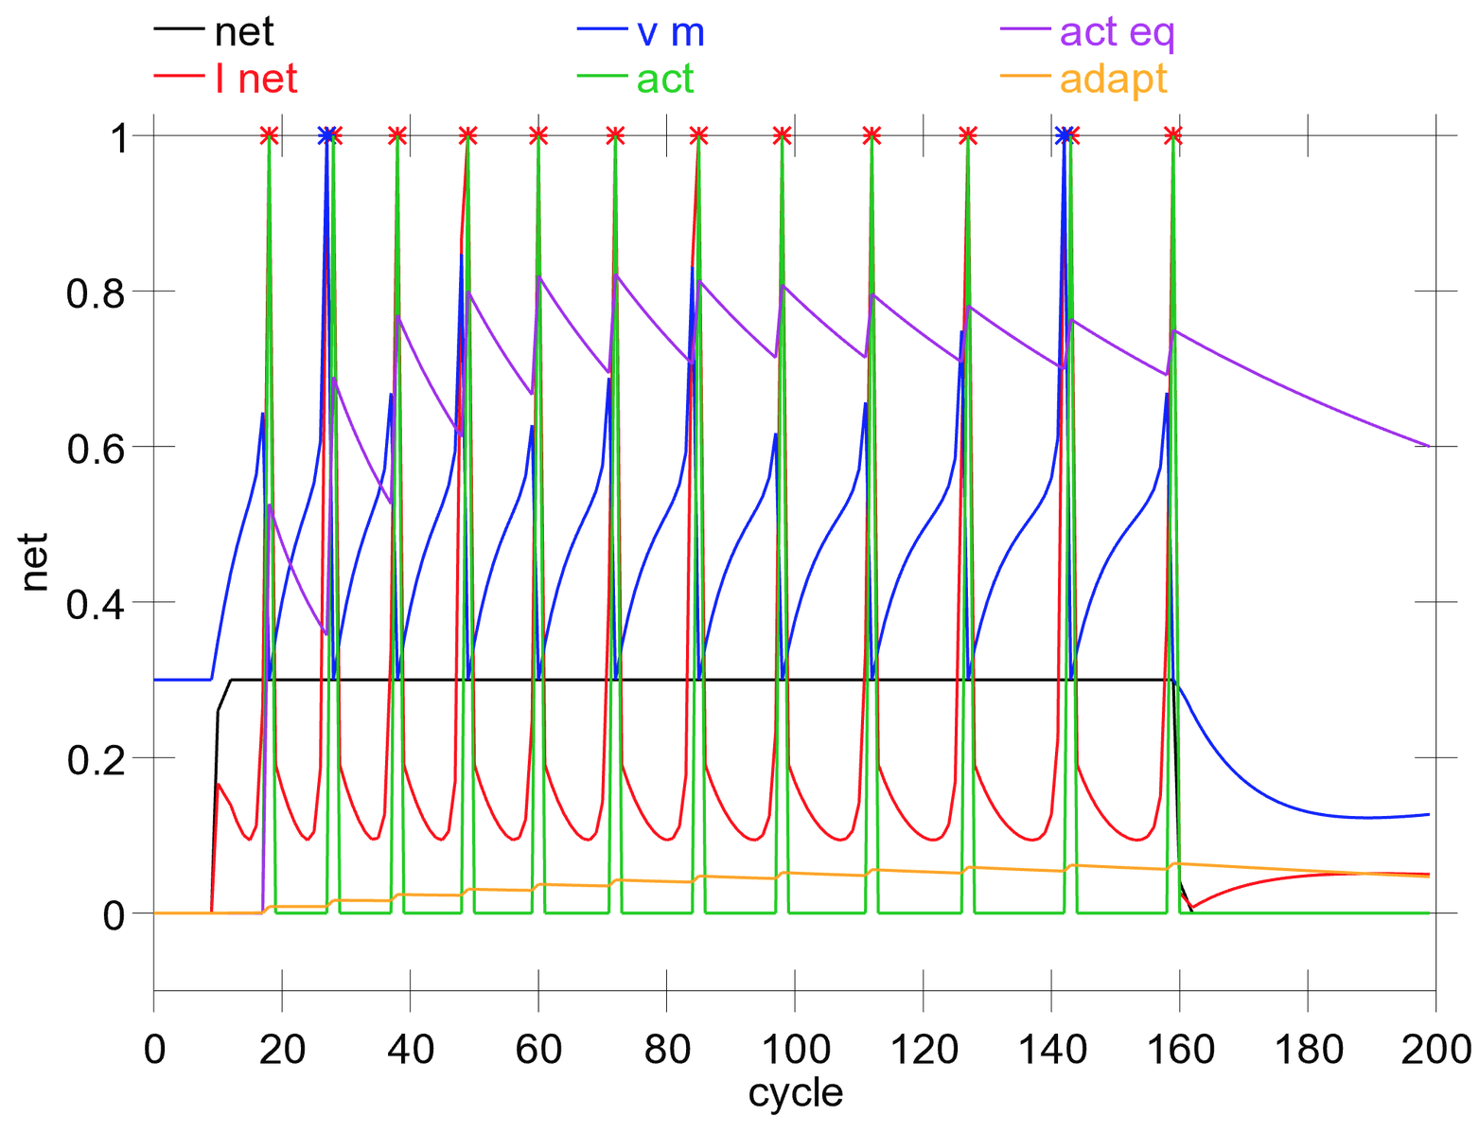
Two Neural Forms of Memory: Activation vs. Synaptic Changes
Activation = Neurons continue to fire action potentials, “remembering” what you were just seeing, thinking
But when firing stops.. You forget..
Synapses change strength (“weight”) as a result of LTP / LTD (learning): this encodes long-term memories that last even after your activation switches to something new..

Slide 8
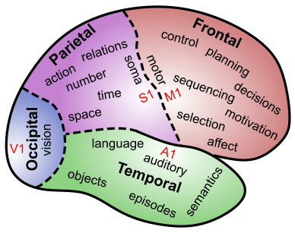
The Brain IS Memory
Memory is located in every single synapse in the brain
There are as many different kinds of memory as there are neurons and synapses and brain areas…

Slide 9
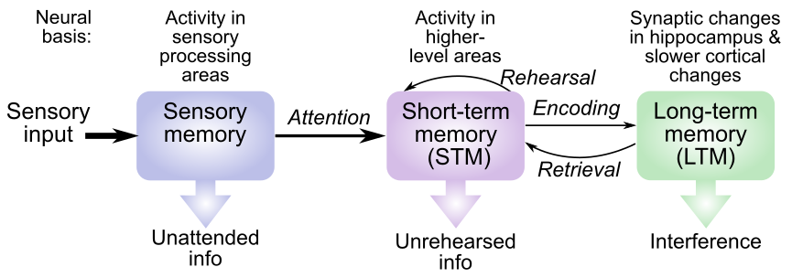
“Modal” Model
Sensory: iconic (visual, < 1 sec), echoic (auditory, < 4 sec)
STM: ~20 seconds max, limited capacity (3-4 really, 5-7 for verbal)
LTM: essentially unlimited capacity

Slide 10
Where is Sensory Memory?
Surprise! It is just neural firing in sensory brain areas – those neurons just keep on firing away (briefly..)

Slide 11
Where is Short-Term Memory?
Surprise! It is neural firing in higher level brain areas that represent specific thing you’re remembering – those neurons just keep on firing away (briefly..)

Slide 12
Where is Short-Term Memory?
Extra surprise! And it usually requires contribution from prefrontal cortex – has extra holding power to keep those neurons firing longer!

Slide 13
Where is Long-Term Memory?
Surprise! It is in the relevant brain area(s) that encode the specific information! LTM is the sum total of all those synaptic weight changes!

Slide 14
“Modal” Model Dynamics
Sensory & STM do not need to be encoded or retrieved: Active..
LTM does need to be encoded and retrieved: Offline
Sensory -> STM requires attention
STM = transient, needs rehearsal to maintain

Slide 15
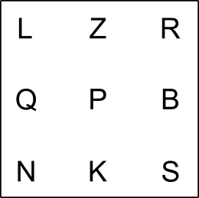
Sperling Task
Full report: remember everything
Partial report: remember middle row
Attentional focus on iconic -> STM

Slide 16
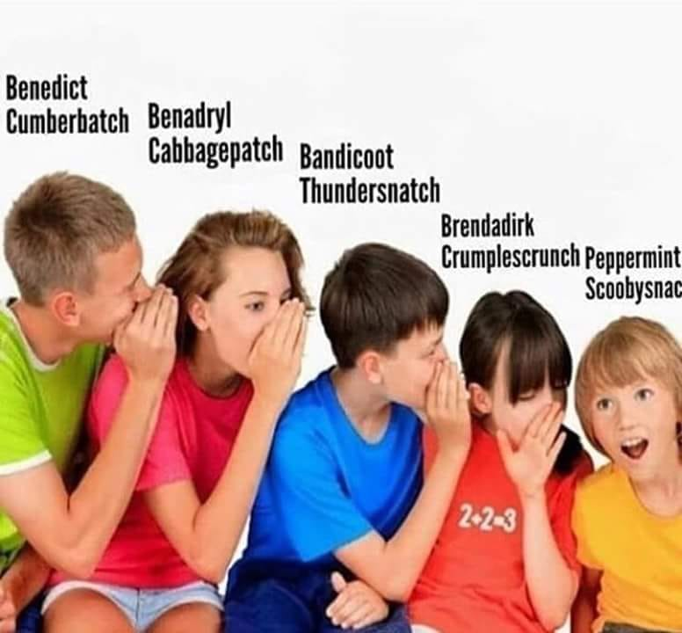
How memories transfer

Slide 17
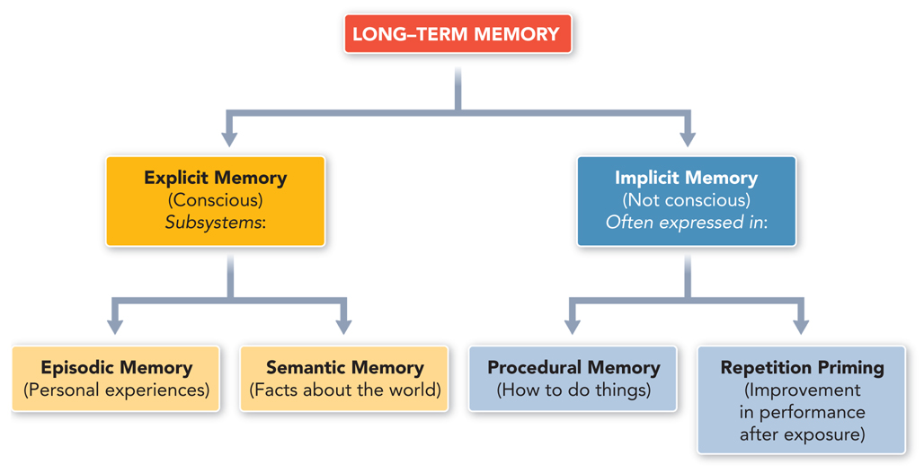
Organization of LTM
Is this the best way to organize LTM? Can you think of any other ways?

Slide 18
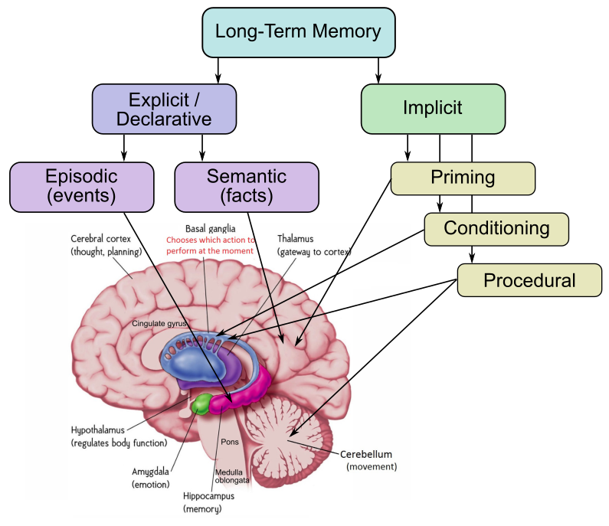
Where is Long-Term Memory?
“Explicit” vs. “Implicit” is unreliable distinction
Episodic = hippocampus
Semantic = rest of brain (mostly)
Procedural = Parietal
Priming happens everywhere..

Slide 19
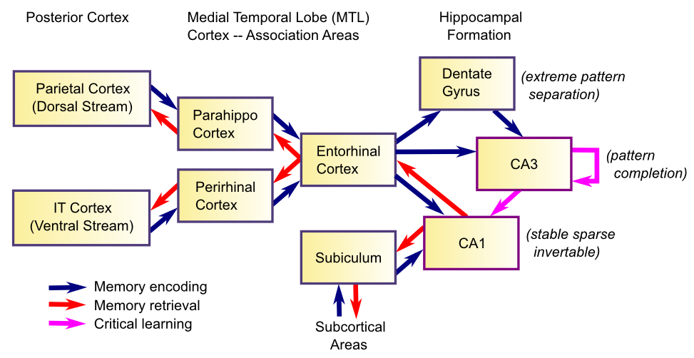
Hippocampal Episodic Memory

Slide 20
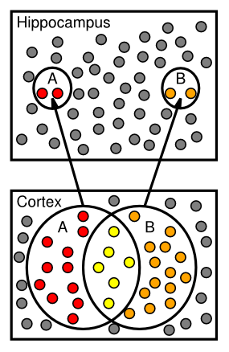
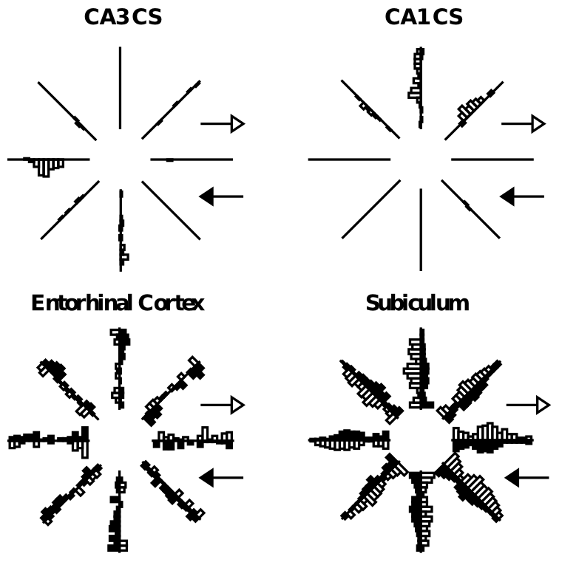
Sparse Activity: Context Specific

Slide 21
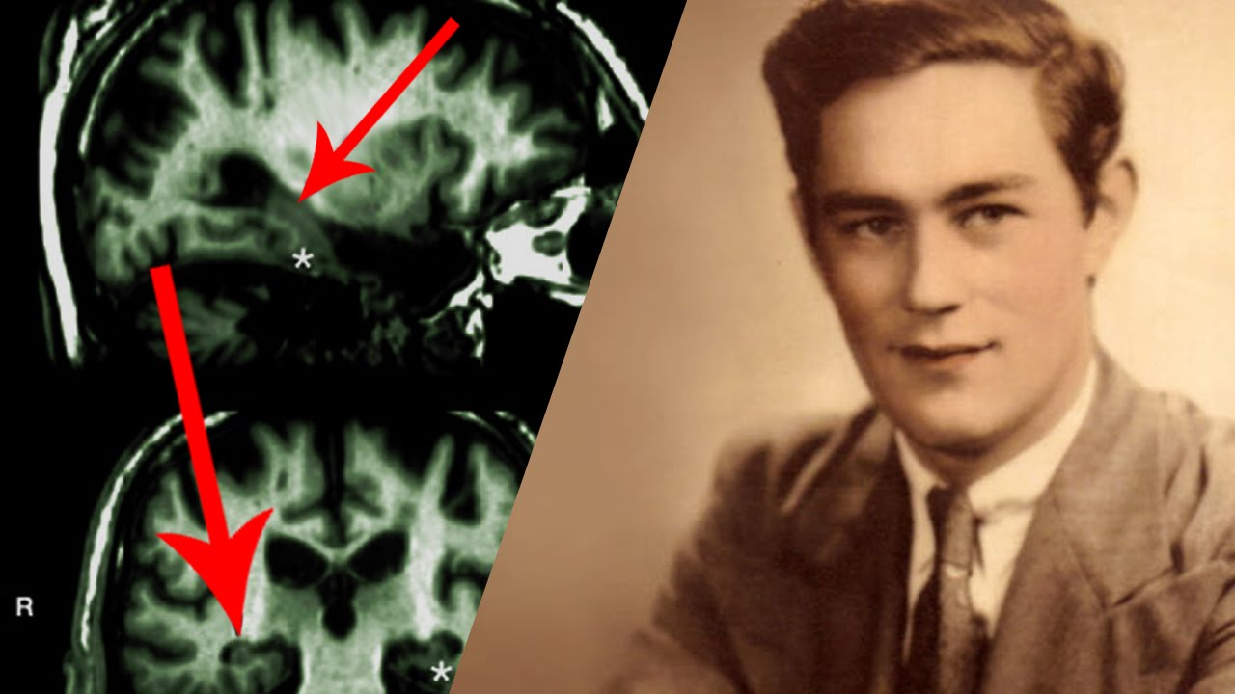

Amnesia
H.M.: epilepsy resection of hippocampus
Still could learn skills: mirror tracing..
Memento (C. Nolan movie)

Slide 22
Learning Rules Across the Brain
Area | Reward | Error | Self Org
Primitive Basal Ganglia | +++ | - - - | - - -
Cerebellum | - - - | +++ | - - -
Advanced Hippocampus | + | + | +++
Neocortex | ++ | +++ | ++
Learning Signal
+ = has to some extent … +++ = defining characteristic – definitely has
- = not likely to have … - - - = definitely does not have
Procedural = Cerebellum, Basal Ganglia
Episodic = Hippocampus
Semantic = Neocortex

Slide 23
How to Improve your Memory
Organize into existing chunks (mnemonics)
Put it in place (method of loci: space is special)
Make connections, and big: elaborate, levels
Generate output: synthesize it
Error signals: Testing effect (quizzes!)

Slide 24
Chunks!
OWA… TAJER… KIAM…
SBCVTMCBNOBH vs. HBONBCMTVCBS
Organizing information into chunks = bigger
Memory Span
SF was able to remember 110 random digits by chunking into running times, etc.

Slide 25
Encoding and Remembering
Deeper encoding = better memory
elaborative encoding (e.g., method of loci – put each thing in its own special place)
Levels of processing: deeper is better!
LTM can be very context dependent (why?)
- state-dependent = a kind of context..
Spaced learning = learning across more contexts – makes memory stronger, more robust!

Slide 26
Episodic -> Semantic
LTM memory typically starts in the hippocampus: encode disjointed “facts” = “events”
Then slowly, rest of brain soaks up these disjointed facts and organizes them systematically into semantic memory in cortex
This is why it takes 10 years to really learn..

Slide 27
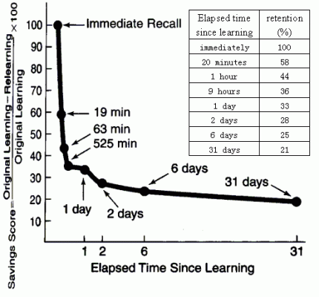
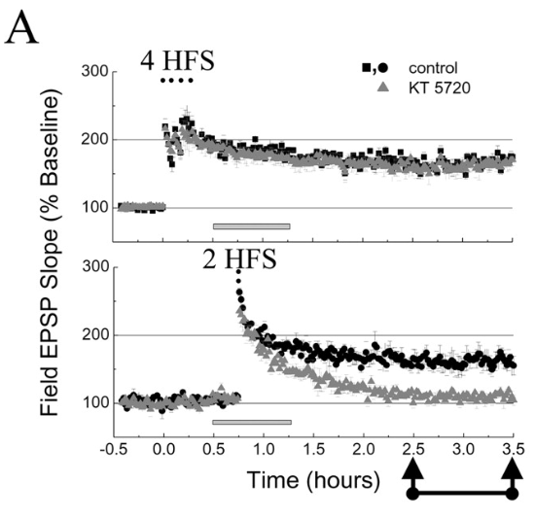
Memory Retention: Decay / Interference

Slide 28
Retro / Pro Interference
Retroactive Interference:
* New learning ruins old (retro) memories
* This is most common form (synapses changing)
Proactive Interference:
* New (pro) learning is worse because of existing
* Rarer: e.g., sure that person is “Robin” but is not..

Slide 29
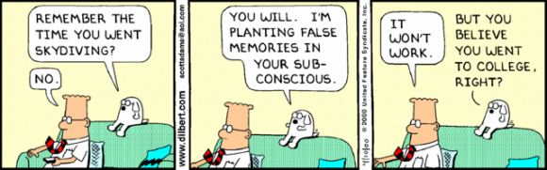
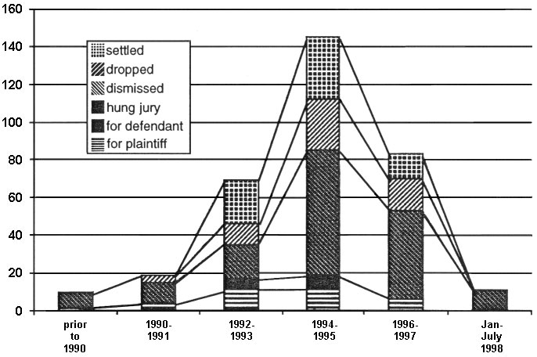
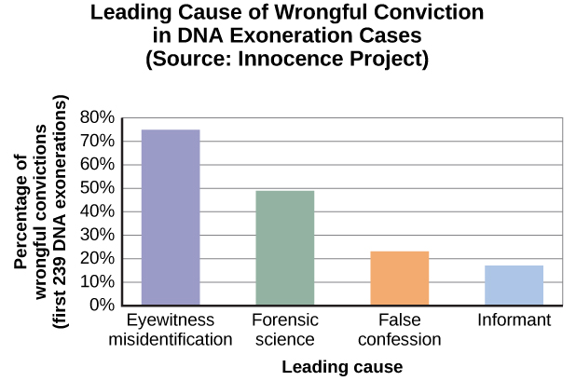
False Memories: Real world issue!
Repressed memory cases

Slide 30
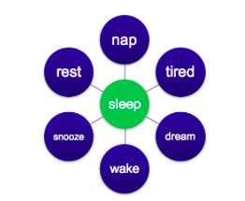
Deese Roediger McDermott

Slide 31
Working Memory vs. STM
Working memory = activity in PFC reflecting stuff you are actively working on
Working memory is a special kind of STM: because PFC is special in not being so easily distractible

